Slide 1

Frontend JavaScript
DOM
www.pragmatic.bg
Lector: Stiliyan Ivanov
Skype: stiliyan.iv.ivanov
E-mail: stiliyan.ivanov [at] pragmatic.bg
Facebook: https://www.facebook.com/stiliyan.iv.ivanov
LinkedIn: https://www.linkedin.com/in/stiliyan-iv-ivanov/
Copyright © Pragmatic LLC 2013 – 2019

Slide 2

Table of contents
What is the DOM?
Events
jQuery
Immediately Invoked Function Expression (IIFE)

Slide 3
What is the DOM?
JS & jQuery book - PDF page 190

Slide 4
Events
JS & jQuery book - PDF page 250

Slide 5
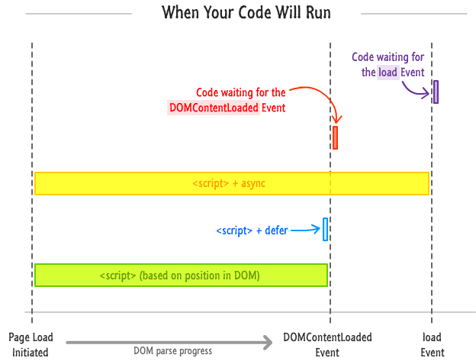
Script Loading Sequence

Slide 6
jQuery
JS & jQuery book - PDF page 300

Slide 7
Immediately Invoked Function Expression (IIFE)

Slide 8
IIFE
An immediately-invoked function expression (or IIFE, pronounced "iffy") is a JavaScript design pattern which produces a lexical scope using JavaScript's function scoping. Immediately-invoked function expressions can be used to avoid variable hoisting from within blocks, protect against polluting the global environment and simultaneously allow public access to methods while retaining privacy for variables defined within the function
External link

Slide 9
IIFE
Immediately-invoked function expression (IIFE)
(function (count) {
for (let i = 1; i <= count; i++)
console.log('+'.repeat(i));
})(4);
+
++
+++
++++
This is called "closure" (a state is closed inside)
let f = (function () {
let x = 0;
return function() { console.log(++x); }
})(); f(); f(); f(); f();
1
2
3
4

Slide 10

Questions?

